Slide 1
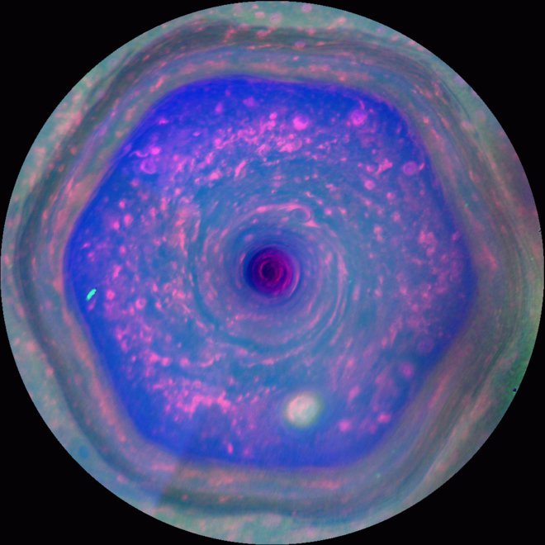
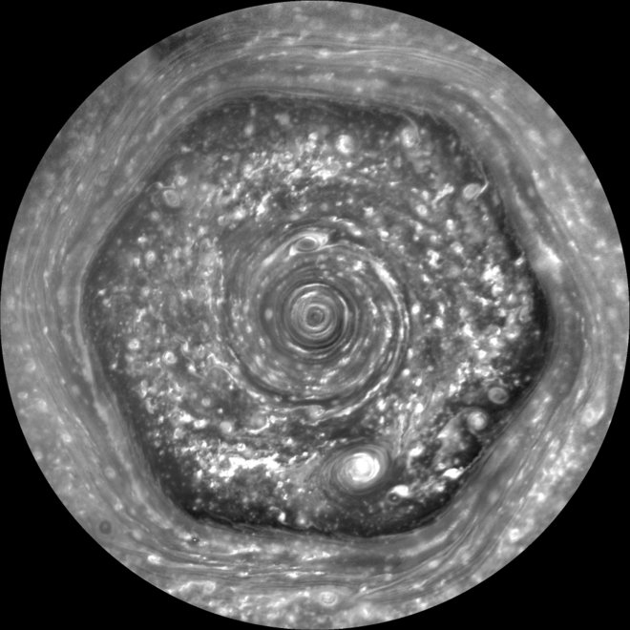
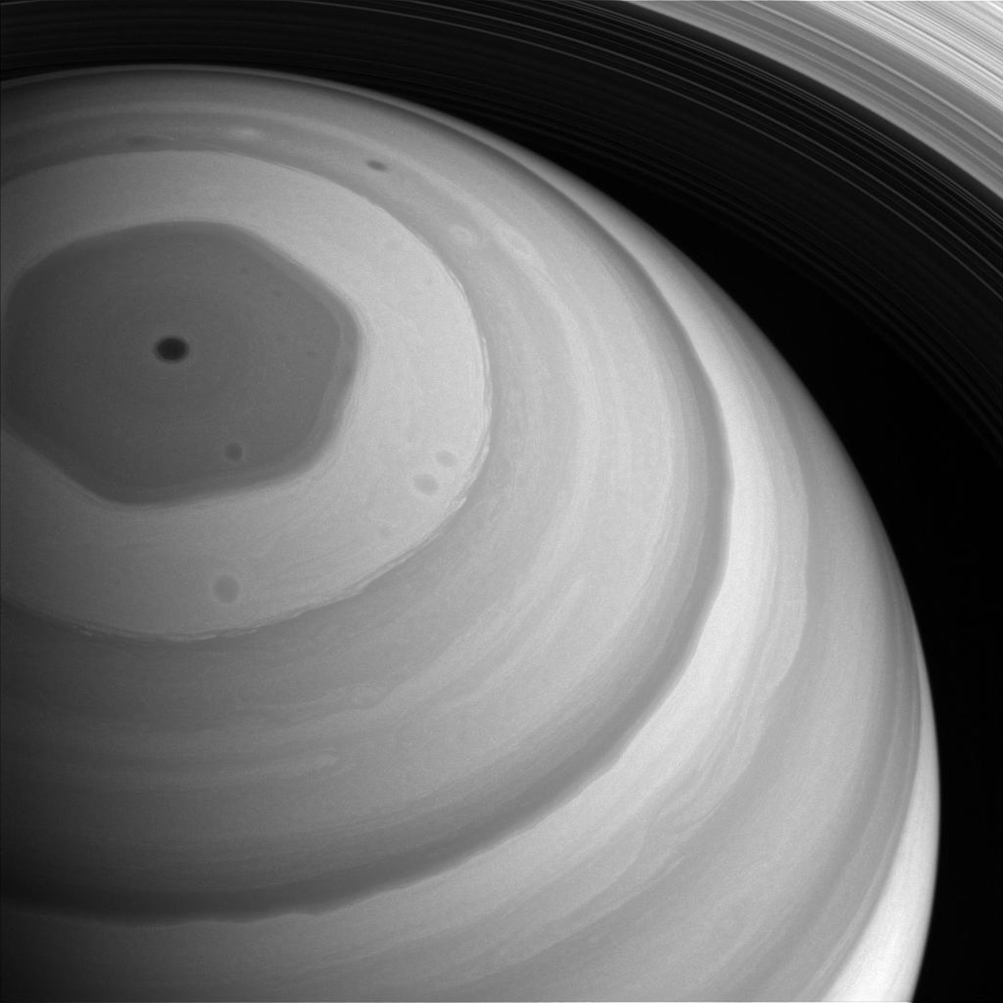
Today in science…
Saturn’s 180-mile tall polar hexagon
Observed by Cassini spacecraft
Notes:
Note: last week, I mentioned dropping fridge-sized bodies onto comets- the Huygens probe (we’ll hear about him later) was dropped into Titan’s (moon of Saturn) atmosphere to see how far it would get before the atmospheric pressure crushed it
https://www.livescience.com/63497-saturn-high-altitude-hexagon-vortex.html
https://www.space.com/41713-bizarre-saturn-hexagon-180-miles-tall.html

Slide 2
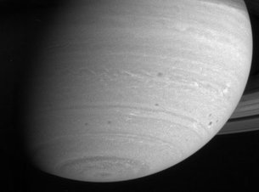
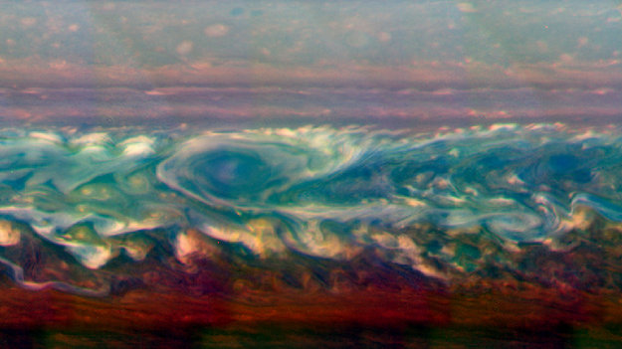
Today in science…
Saturn is tilted 26 degrees
Rotating counterclockwise (anyone know why?)
Atmosphere is stratified: gases of different composition, temperature, density, separate
Stunningly beautiful and dynamic! Also, deadly
Mostly H, but also He, methane, ammonia, etc
Ammonia
Ammonium hydrosulfide
Water clouds
Intermingled hydrogen: gas up top, liquid phase down low (increasing pressure)
Liquid helium below that
Notes:
https://www.nature.com/articles/s41467-018-06017-3
https://www.esa.int/Our_Activities/Space_Science/Cassini-Huygens/Saturn_s_atmosphere

Slide 3
Recap from last time…
Conservation laws
Momentum
Angular momentum
Energy
Newton’s universal law of gravitation
Depends on product of the masses of two bodies
Decreases as 1/d² – inverse square law

Slide 4
Something I forgot last time!
Two bodies orbiting common center of mass
We can detect the more massive body’s tiny orbit, it’s how exoplanets were discovered!
x

Slide 5
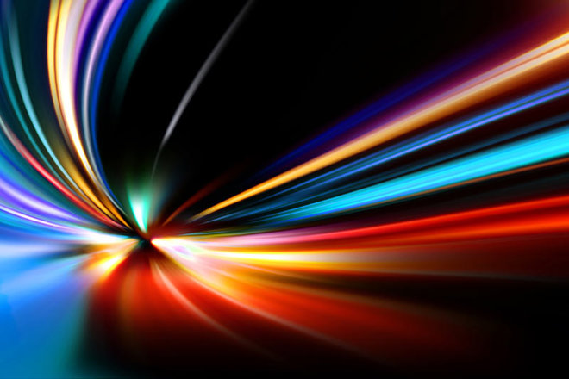
Properties of light
The Cosmic Perspective, Chapter 5, 5.1-5.2

Slide 6
Today…
We’re going to learn why the sky is blue
And why plants are green*
*…mostly
Notes:
Why are we learning this in an astronomy class? Because it’s light!!!

Slide 7
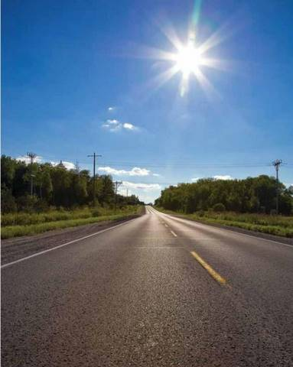
How do we experience light?
It’s bright: reflections and scattering are how we see anything
It’s warm: we can tell light is a form of energy
Sunlight warms our skin
Sunlight heats up asphalt, which radiates that heat back at us
It’s colorful: we’ve all seen prisms or materials that behave like them (rainbows on CDs)
Notes:
We’re now 25% through the course!
Last time we talked about forms of energy: kinetic, potential, and I mentioned radiative was next- here we go

Slide 8
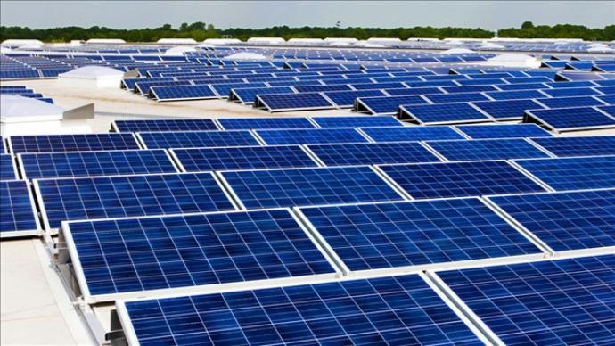
Light as a form of energy
Consider walking outside or sitting by a window in the sun
Your skin gets warmer
Light is transferring energy to your skin
Your thermal energy is increasing, as light speeds up
molecules and atoms in your skin
The energy light has is called radiative energy
Units of energy are Joules (aka g*m²/s²)
For radiative energy, we think more in terms of the rate of energy: we can’t store a beam of sunlight itself, but if it hits a surface long enough to deliver enough energy, something like solar panels can charge
Power: measured in Watts
1 Watt = 1 Joule/second
Notes:
https://www.nbc15.com/content/news/UW-Students-gift-Project-Home-with-25000-solar-array-482130901.html

Slide 9
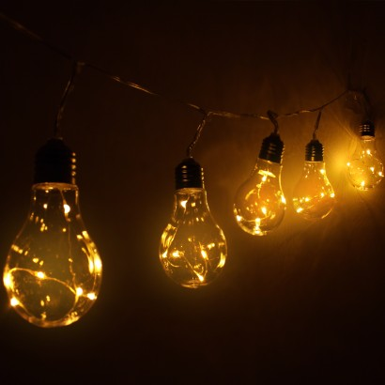
Behavior of light
A source of light emits it
Example: you turn on a lamp. Electricity flows through a filament, which heats up, and the hot filament glows
Objects with thermal energy emit light in some wavelength: this is called thermal emission, or thermal radiation
Emission of thermal radiation takes energy away from its source, causing it to cool
Why doesn’t the light bulb cool?
Continued supply of electricity

Slide 10
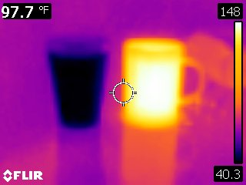
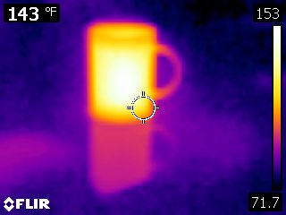
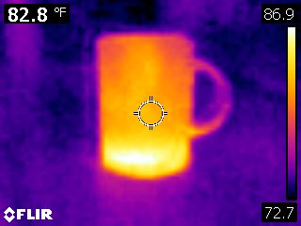
Behavior of light
What else emits thermally?
We do! We have temperature, we emit! We’re relatively cool though, so we emit in the infrared (less energetic than visible light)
Why do we cool?
We’re in thermal contact, energy is flowing from us to cooler surroundings

Slide 11
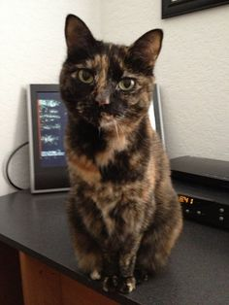
Behavior of light
Light can be absorbed
Example: you’re trying to enjoy a fire (camping, fireplace), and someone sits in front of you. They’re absorbing the light, and they’re getting warm from the energy they’re absorbing
Another: you’re watching the game and someone walks in front of the TV. They absorb the light (in this case, they don’t get warm because the power output of the TV is much lower than a fire)
So you tell the person, ”you make a better door than a window…”
Notes:
This is Taffy, a tortoise kitty https://www.pinterest.com/emesero/tortie/

Slide 12
Behavior of light
Light can be transmitted
If the person between you and the TV is holding a clear piece of glass, light goes through and they’re a little bit less annoying (but weird for bringing a piece of clear glass over to make a physics point)
Light is transmitted through glass, but not all light
Can you get a sunburn in a car with the windows up?
Transparent: some light (and energy) can go through
Opaque: no light (or energy) can go through
Transparency and opacity often depend on energy of the light
Notes:
This is what you get when you google, “glass in front of TV” … either my imagination is lacking, or weird

Slide 13
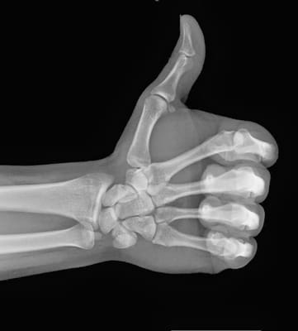
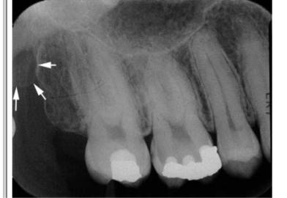
Behavior of light
Transparency vs opacity

Slide 14
Behavior of light
Light can also reflect and scatter
Reflections are orderly, like in a mirror
Scattering is random in direction, like light in Earth’s atmosphere, or light off particles in the solar wind
Scattering depends on energy of the light being scattered and the size of the scattering body
Notes:
Remember the absorption example? To you, the person blocking the fire seems to be absorbing all the light. They’re also reflecting it to people who can see them from the other side
http://blog.girlscouts.org/2014/05/

Slide 15
Behavior of light
Why are sunsets red?
Scattering!
New concept: airmass
horizon
Notes:
Imagine you’re an enormous stick figure standing on an entirely green globe
You look up through a thinner chunk of atmosphere than if you looked directly out over your horizon. The atmosphere is really good at scattering blue light and bad at scattering red.. The more atmosphere is on your line of sight, the more blue light gets scattered and the less red does, so you see more red when looking through more atmosphere

Slide 16
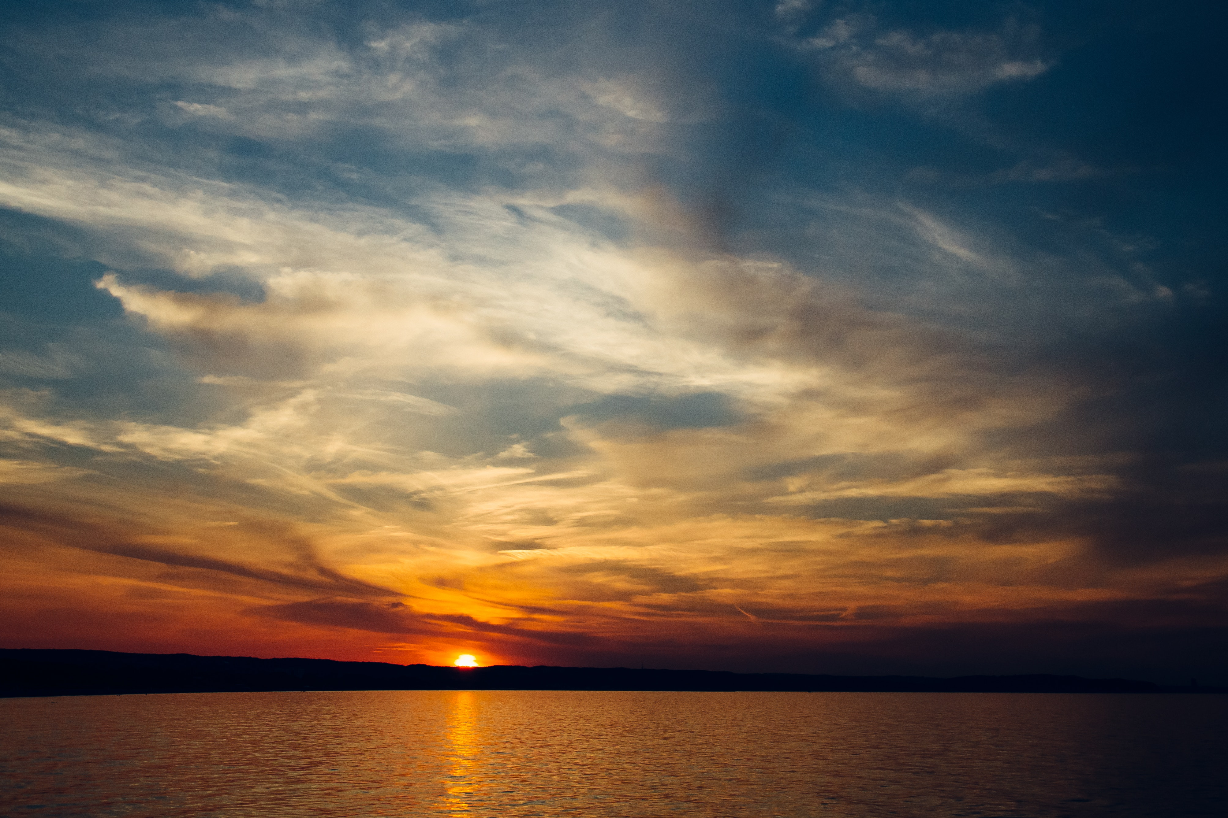
Behavior of light
Notes:
It took me a long time to find this photo. It shows scattering, reflection, and absorption
https://www.pexels.com/photo/sea-sky-sunset-water-8101/
The atmosphere is really good at scattering blue light, and red light is scattered the least. At sunset,

Slide 17
Behavior of light
Why else might the sky be blue and the sunset red? What have I not mentioned yet?

Slide 18
Behavior of light
Why else might the sky be blue and the sunset red? What have I not mentioned yet?
Our eyes’ sensitivity to light!
Notes:
http://people.eecs.berkeley.edu/~cecilia77/graphics/a6/
Humans have red, green, and blue receptors in our eyes. Different balances of sensitivity to each color can lead to differing color vision from person to person! If we aren’t sensitive to red, sunsets could look a bit different

Slide 19
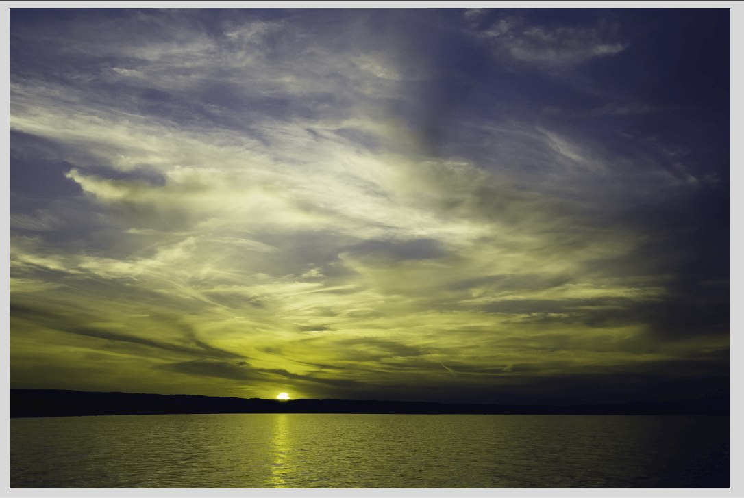
Behavior of light
Notes:
Deuteranopia –called “red-green colorblindness,” it’s either the green or red cones that detect at lower levels, but the end effect is the same; red and green are indistinguishable

Slide 20
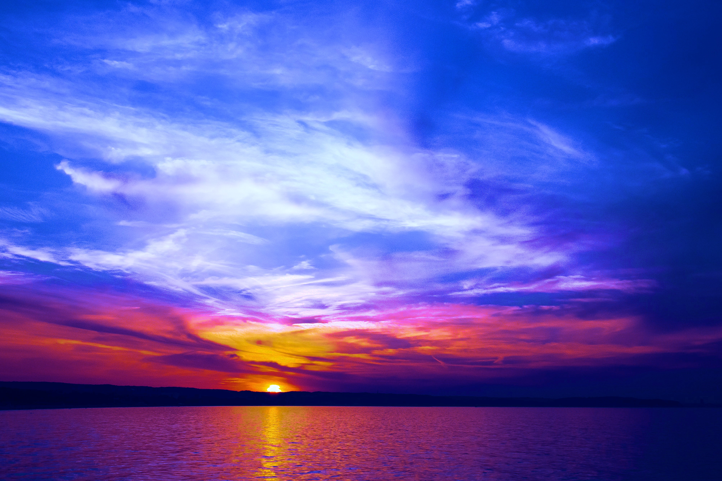
Behavior of light
Or, if our eyes were most sensitive at different wavelengths, maybe it would look like this
Notes:
If we were more sensitive to blues/purples, perhaps

Slide 21
Light and color
Remember Neil deGrasse Tyson talking about Roy G Biv? And Newton, his fixation with the number 7, and his work on optics/light?
White light (all colors) → prism → spectrum (rainbow)

Slide 22
Light and color
How do rainbows work?
Water droplets act like prisms
…hair goals.
Notes:
http://skywaterland.com/Ireland.html
And the hair, yes https://www.businessinsider.com/baby-rainbow-hair-perfect-for-festivals-2018-3?r=UK&IR=T

Slide 23
Light and color
Remember Neil deGrasse Tyson talking about Roy G Biv? And Newton, his fixation with the number 7, and his work on optics/light?
White light (all colors) → prism → spectrum (rainbow)
Do astronomers use prisms?
Kinda. We call them diffraction gratings
How do prisms and diffraction gratings work?
Notes:
http://www.inprentus.com/diffraction-gratings/ (not an advertisement; got result from GIS)

Slide 24
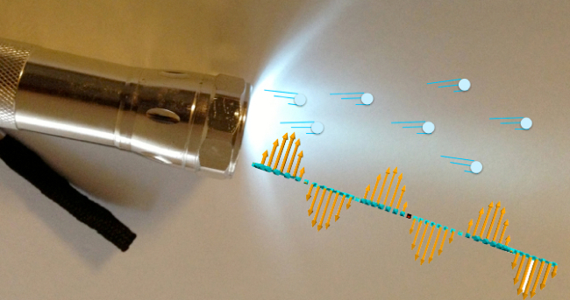
Properties of light
In the 1660s, Newton had some ideas…
It’s obviously a stream of particles, delivering energy!
In the 1670s, Dutch physicist Christiaan Huygens had ideas, too
It’s a wave! It behaves like waves would
What is light?
Notes:
This is one of those infuriating questions- obviously we know what light is, we interact with it all the time! But … what is it?
https://www.wired.com/2013/07/is-light-a-wave-or-a-particle/

Slide 25
Particles and waves
Individual molecules, atoms, and the things that make up atoms, are examples of particles
Examples of things that behave like particles: a marble, a ball
Can have positions, momenta; can exert forces
Particles are the things
Waves are motions that move through a medium and have distinct properties
Example: waves in water
Waves move the things
Waves have slightly different properties…
Notes:
https://abcnews.go.com/Lifestyle/photos/surfing-dogs-hang-10-charity-25838539/image-25839087

Slide 26
Properties of waves
Wavelength
Amplitude
Frequency
High= more energy
Low= less energy

Slide 27
Properties of waves
Wavelength: the distance between two peaks. Units: distance. So meters, cm, mm, nm (10⁻⁹m). Astronomers who study visible light often use Angstroms, 10⁻¹⁰m. X-ray astronomers use units of energy; radio astronomers often use units of frequency instead of wavelength! (think: car radio frequencies)
Frequency: how frequently do the peaks pass by? Units of 1/s (think, ‘peaks passing by per second,’ or ‘cycles per second’). 1/s also called Hertz, abbreviated Hz
Amplitude: units vary, but it relates directly to the brightness of the source emitting the wave
Examples: waves on earth. Tidal variations ~1m (recall lunar tides from last class). Tsunamis: ~tens of meters in amplitude (30m ~ 100ft!)
Speed: how fast the peaks travel
What is the speed for light waves?

Slide 28
Electromagnetic waves
Certain fundamental quantities in physics are described as fields based on how they interact with each other and with particles
Example: gravitational fields

Slide 29
Electromagnetic waves
The interaction of charges and charged particles are governed by electric fields
Magnetic fields occur when charged particles move; they interact with each other and with charged particles
Light is thought to be a wave that travels through both electric and magnetic fields at the same time
Light interacts with gravitational fields

Slide 30
Ok, so… what is light?
It behaves like both a wave and a particle
In quantum mechanics, this is called wave-particle duality
Discrete “particles” of light are called photons
Photons carry energy
Higher energy photons – shorter wavelength light (think: X-rays, UV light)
Lower energy photons – longer wavelength light (think: radio waves)

Slide 31
The electromagnetic spectrum
Temperatures: 310K 6000K 10⁶K
Notes:
These are temperatures corresponding to the wavelength scale above, not the sizes of things listed…

Slide 32
How do prisms and gratings work?

Slide 33
Astronomical spectrographs

Slide 34
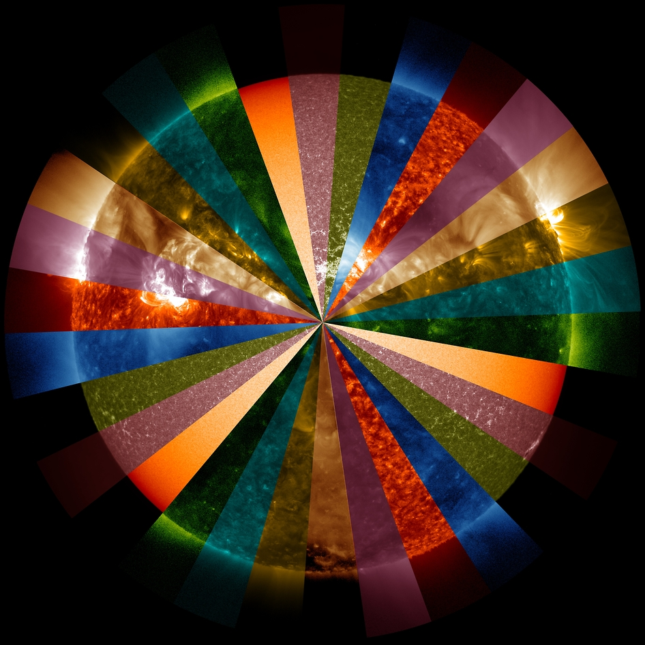
The Sun
What color is the Sun?
Notes:
Think/pair/share?
https://www.nasa.gov/content/goddard/sdo/wheel-of-colorful-sun-sdo5/

Slide 35
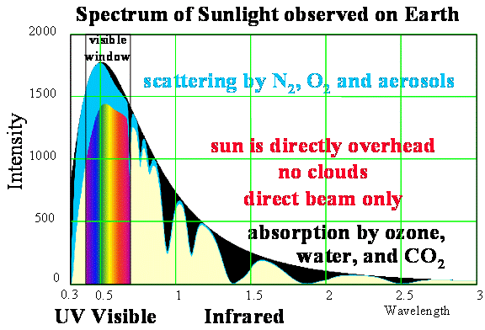
Notes:
https://web.calpoly.edu/~rfield/Thermalstructure.htm

Slide 36
Ok, so why are plants green?
It’s complicated…
Color is what we see when some wavelength(s) of light is(are) reflected back at us and others are absorbed
Common misconception: plants are green because the Sun peaks in green wavelengths
But if we see green, it means that light was reflected back at us!
It’s too much green—plants would potentially overheat if they absorbed all that green
Question for the weekend: What color would plants be around other stars that emit different amounts of light in different colors than the Sun does?
Notes:
https://everwideningcircles.com/2018/03/14/why-are-plants-green/

